Slide 1
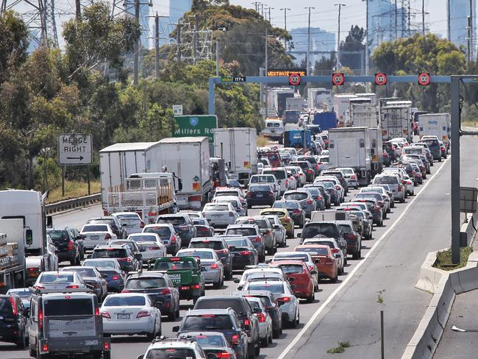
AUSTRALIAN ROAD FATALITIES PRESENTED BY TEAM 5 17 APRIL 2023

Slide 2
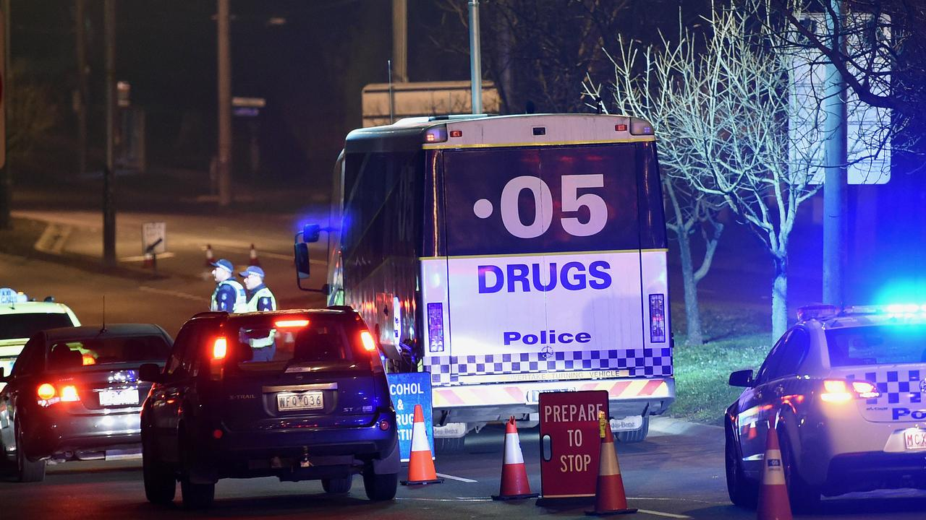
QUESTIONS DERIVED FROM DATA
What is the general trend for road fatalities in Australia over the past 30 years?
Anova test : Was the variance in States’ road fatalities month by month during covid lockdown following a similar variance?
Null Hypothesis: There was no variance across States’ road fatalities across the 3 years of Covid month by month.
Specifically in the last four years, is there a trend regarding various factors (speed limits, age, time of day or day of week, remoteness of the region, or type of road) as related the number of fatalities?
Specifically in Victoria, did the introduction of booze buses and mobile speed radars have a significant impact on road fatalities?
In 1999, Victoria rewrote various road regulations. Did this change have a significant impact on road fatalities? How did this compare to NSW across the same period?
Notes:
From the dataset and intel from our source, the above questions were created.
Each of us have taken on a question to present our findings.
Before we do, Barani will take us through how the data was cleansed in order for us to complete our analysis.

Slide 3
DATA EXPLORATION & CLEANING:
Imported source data from Australian Bureau of Statistics
54000+ records with 23 columns
Remove unwanted and invalid information using loc() and drop null functions
Remove incomplete data (Year 2023)
Verification
Notes:
From the dataset and intel from our source, the above questions were created.
Each of us have taken on a question to present our findings.
Before we do, Barani will take us through how the data was cleansed in order for us to complete our analysis.

Slide 4
What is the general trend for road fatalities in Australia over the past 30 years?
SANDEEP SUMITHRAN

Slide 5
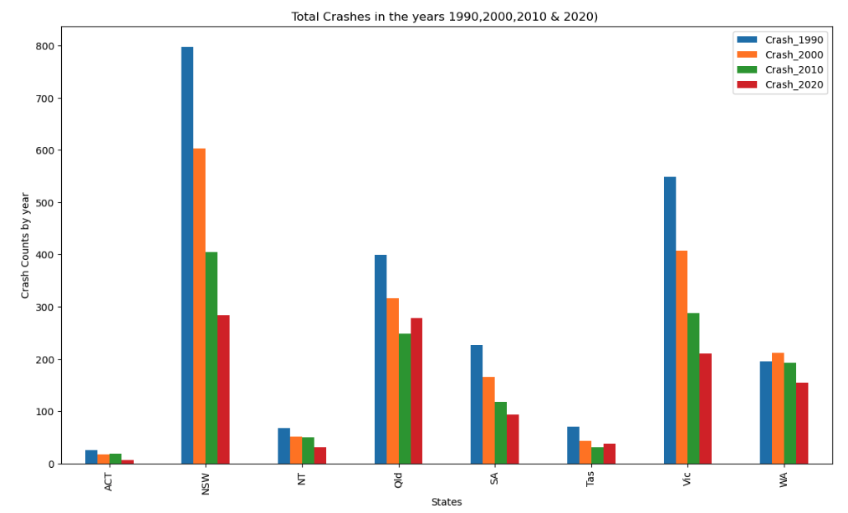
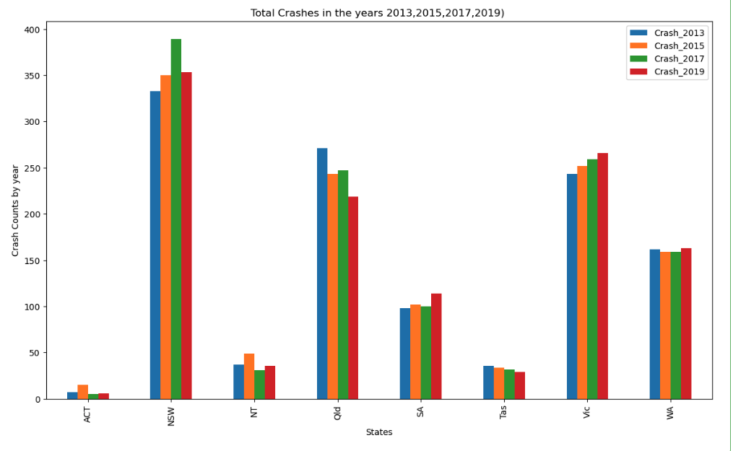

Slide 6
Anova test : Was the variance in States’ road fatalities month by month during covid lockdown following a similar variance?
Null Hypothesis: There was no variance across States’ road fatalities across the 3 years of Covid month by month.
RICHARD SOOS

Slide 7
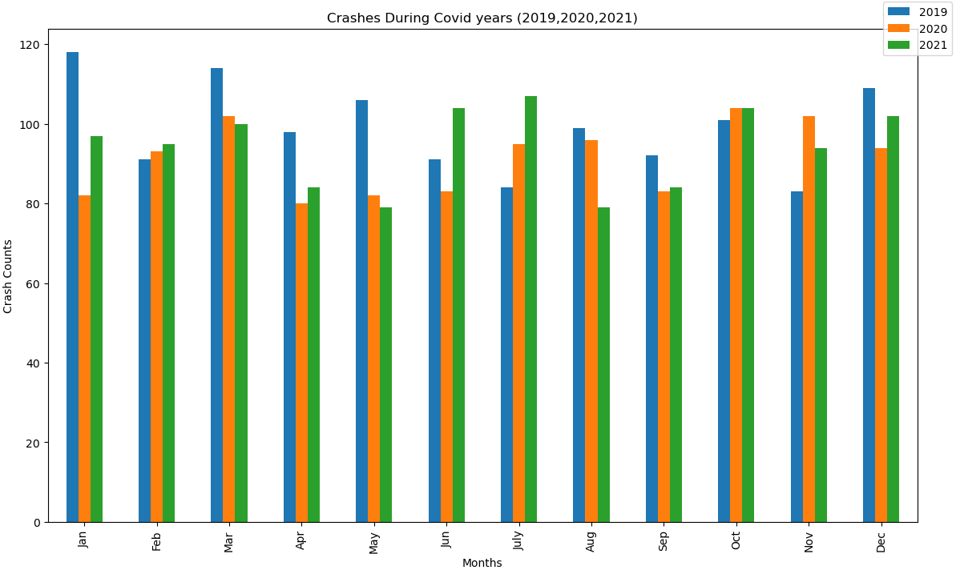
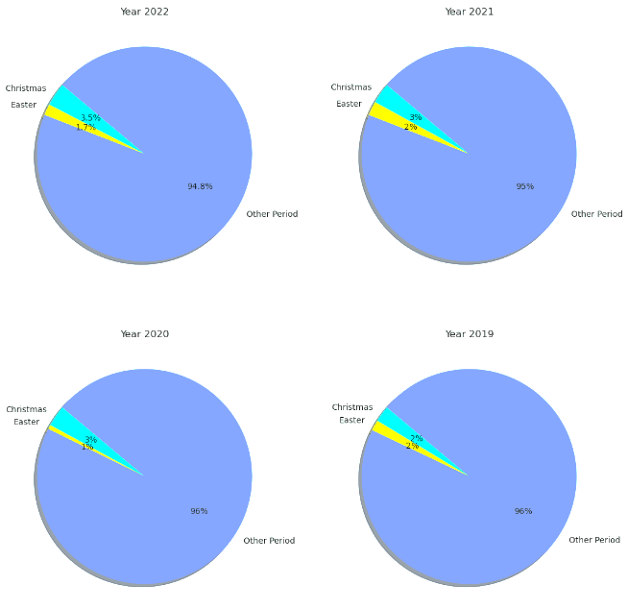
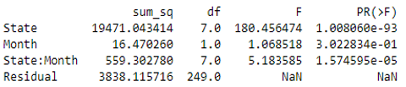

Slide 8
Specifically in the last four years, is there a trend regarding various factors (speed limits, age, time of the day, day of the week, & type of road) as related to the number of fatalities?
BARANI PALANIAPPAN

Slide 9
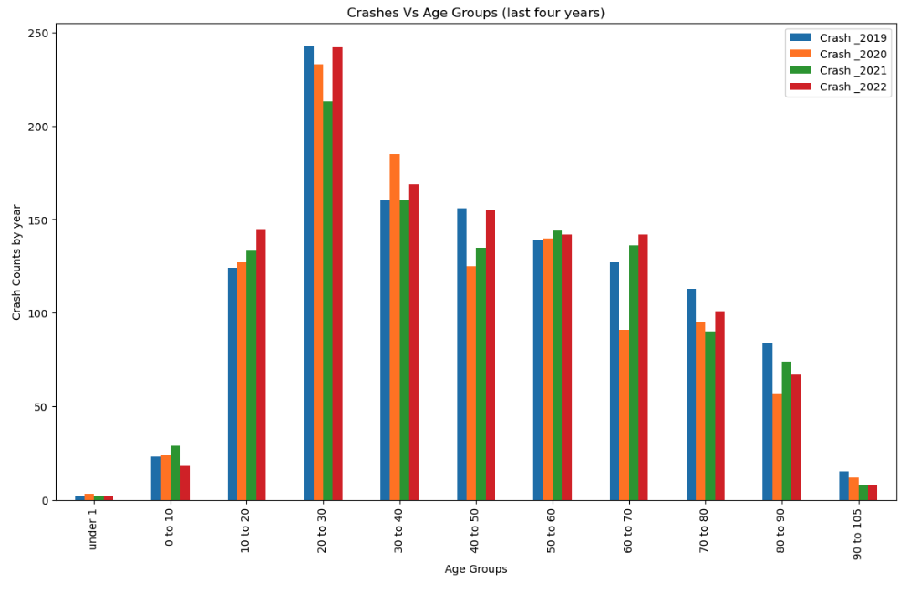
Crash Distribution vs Age Groups from 2019 to 2022

Slide 10
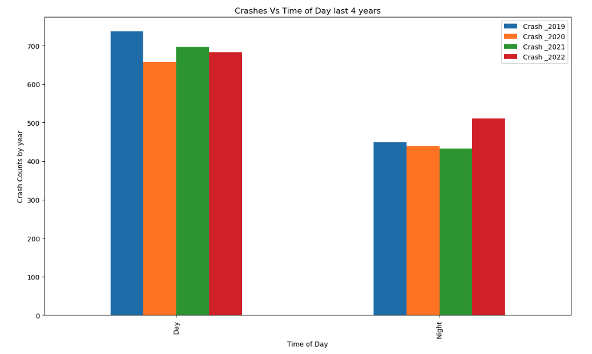
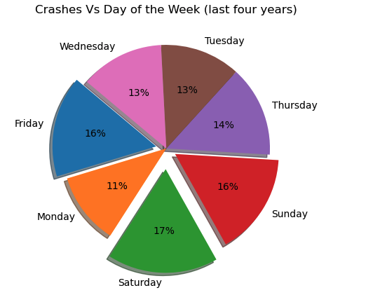
Crash Distribution vs Time of the Day & Day of the week from 2019 to 2022

Slide 11
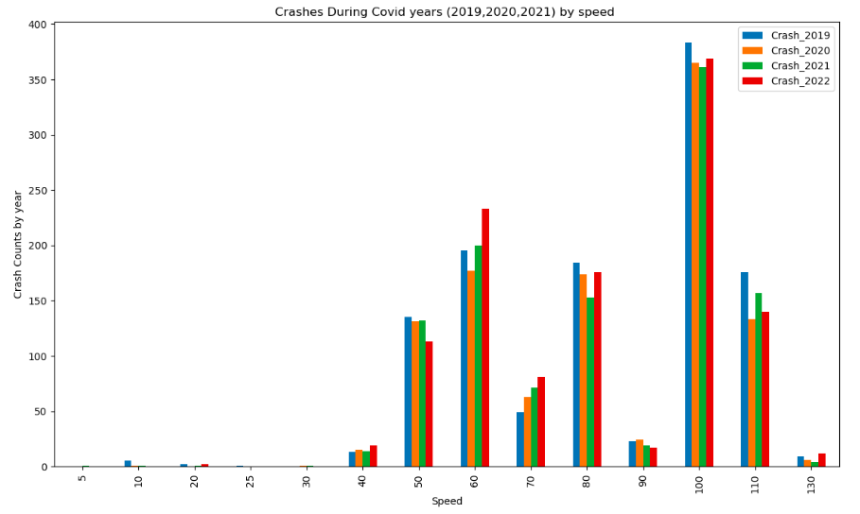
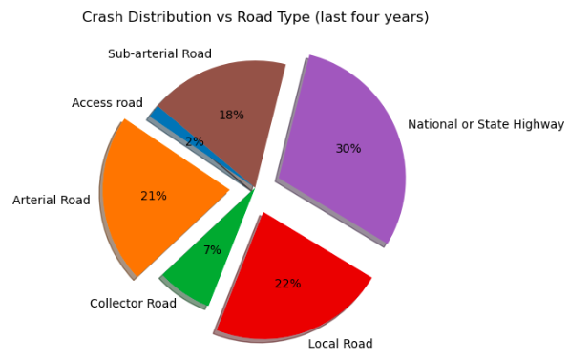
Crash Distribution vs Speed, Road Type from 2019 to 2022

Slide 12
Specifically in Victoria, did the introduction of booze buses and mobile speed radars have a significant impact on road fatalities?
SURAKSHA REGMI

Slide 13
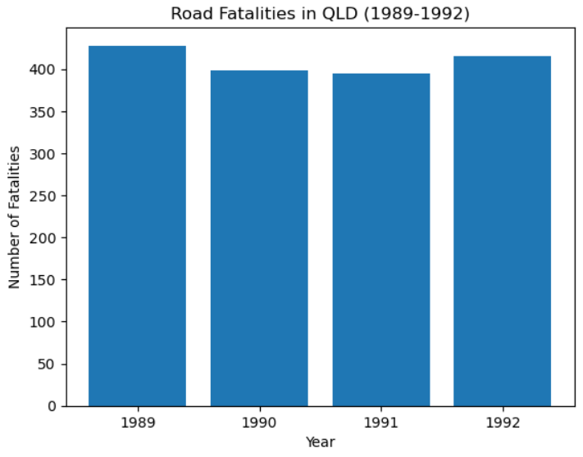
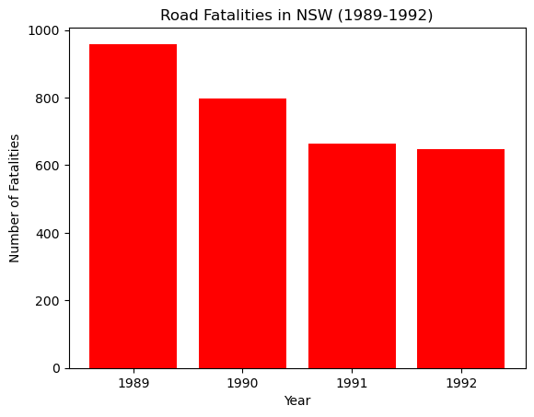
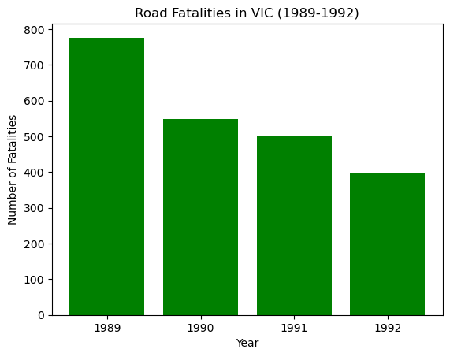
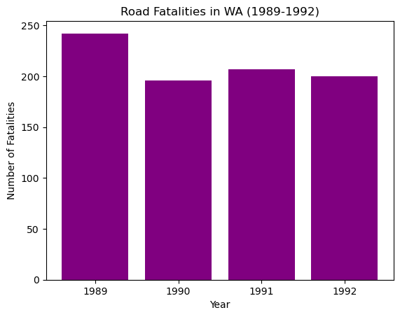
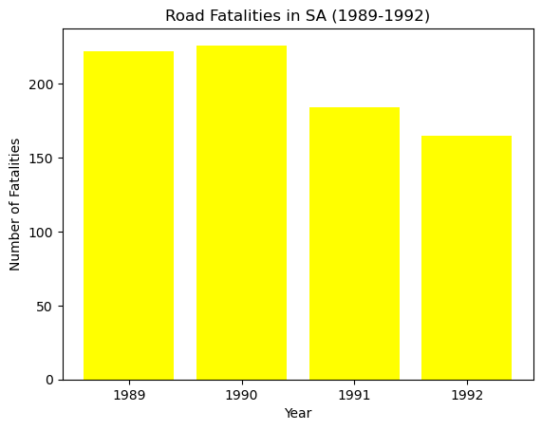
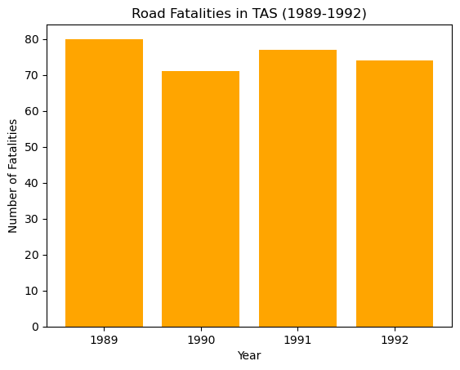
Booze Bus Analysis

Slide 14
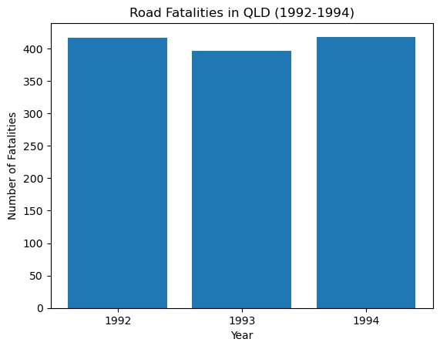
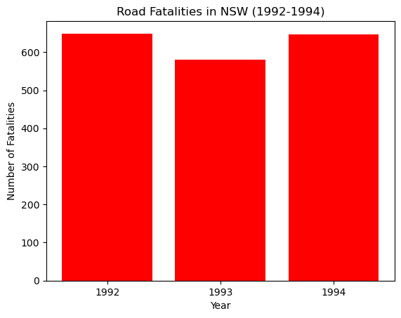
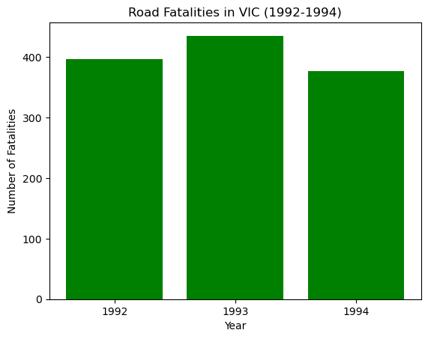
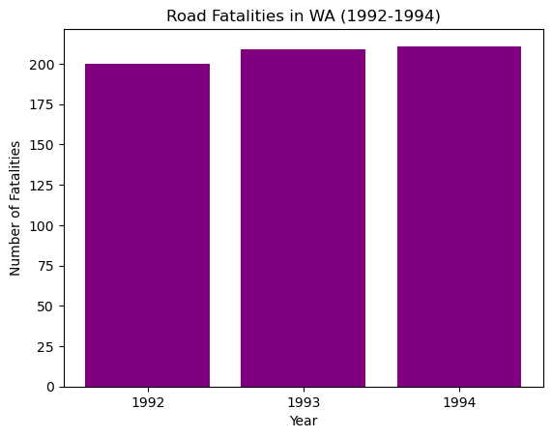
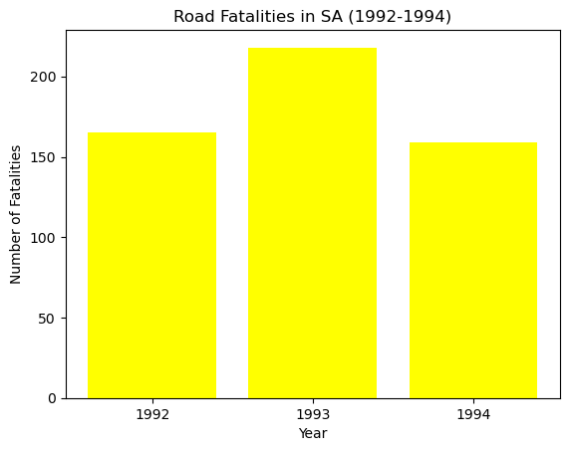
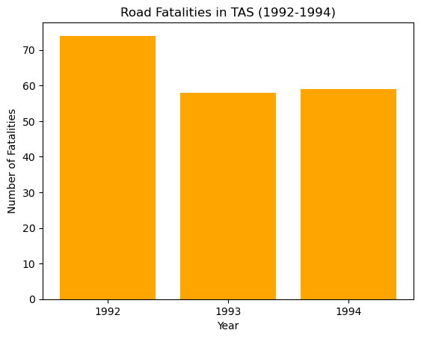
Mobile Speed Radar Analysis

Slide 15
In 1999, Victoria rewrote various road regulations. Did this change have a significant impact on road fatalities? How did this compare to NSW across the same period?
BILLIE- ODELLE GORE

Slide 16
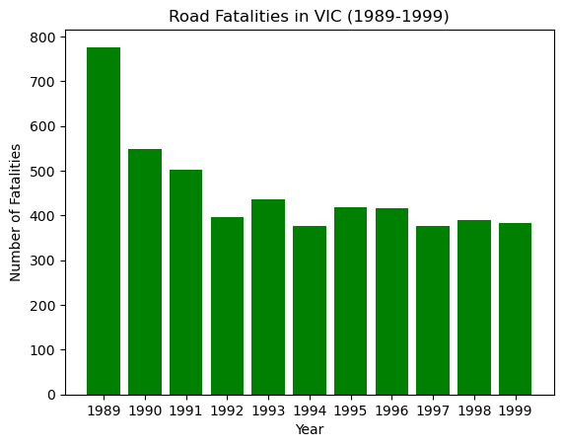
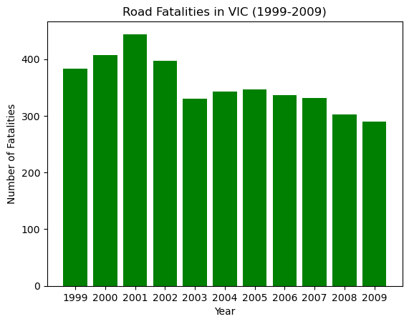

Slide 17
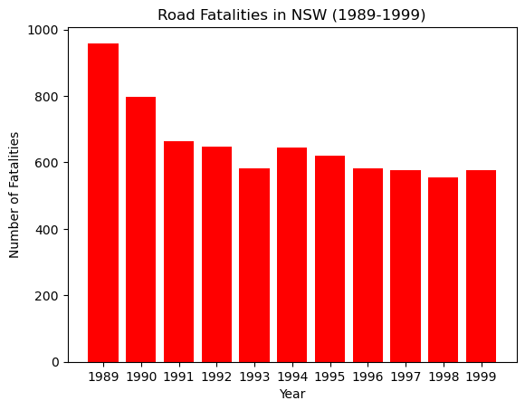
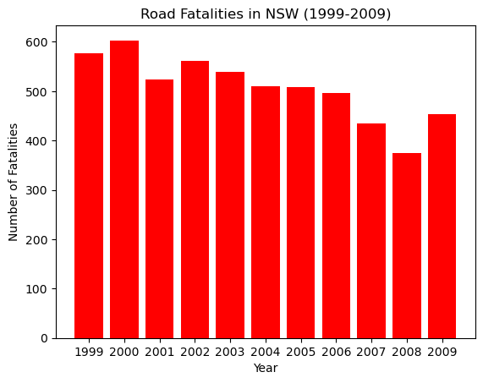

Slide 18
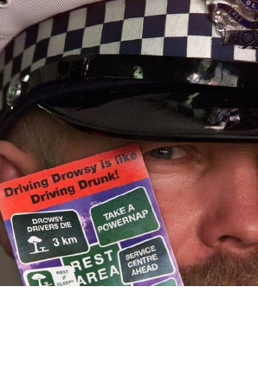

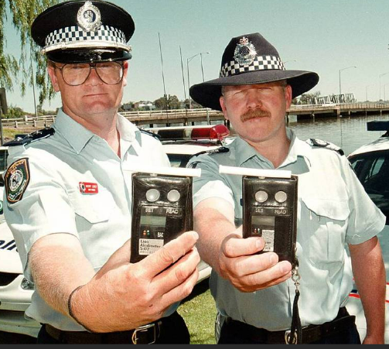
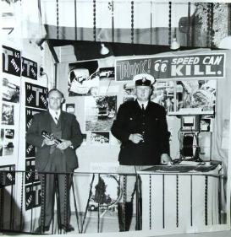
THE END

